Slide 1
Glenn's Bay Road Widening and Interchange Project
October 9, 2014

Slide 2
Project Background
Part of the RIDE II One Cent Capital Sales Tax Program
9th Priority on RIDE II Program
Estimated $80 million total project cost
Project includes an interchange at US 17 Bypass and Glenn's Bay Rd. and the widening of Glenn's Bay Rd. from U17 Bypass to US 17 Business.

Slide 3
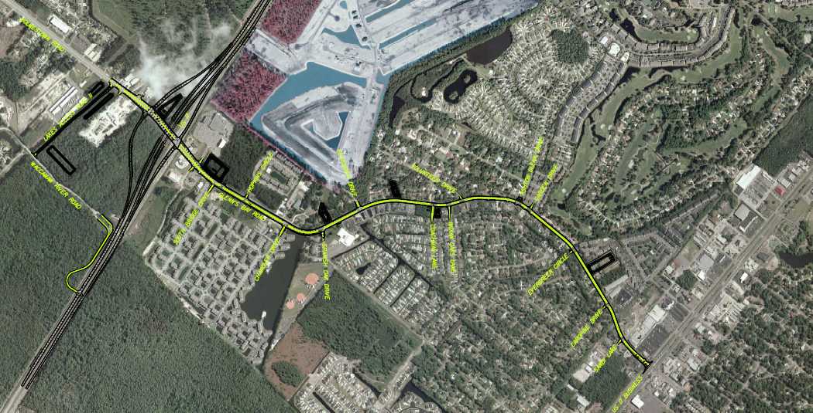
Glenn's Bay Road Widening and Interchange at US 17 Bypass

Slide 4
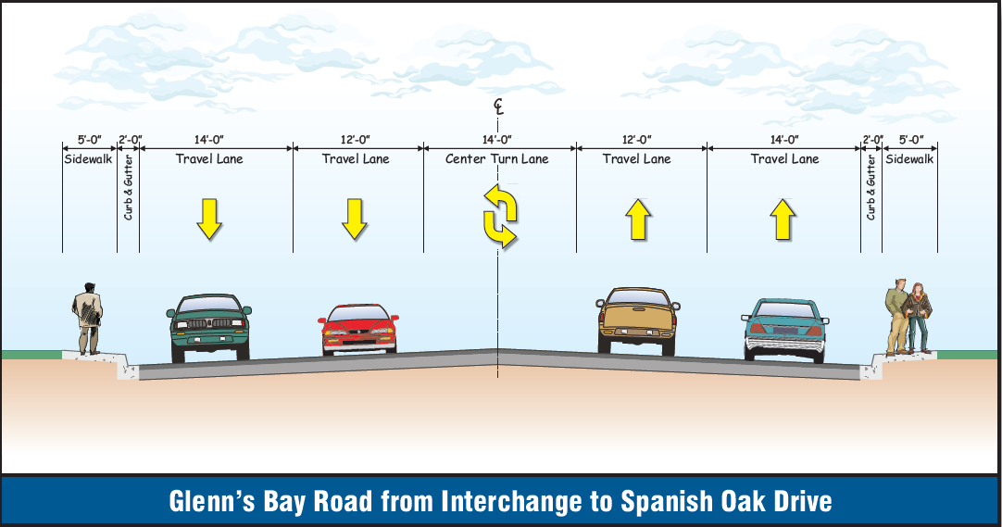
Cross Section of Glenn's Bay Rd.
5 lane cross section from Interchange to Spanish Oak Drive.
Lane drops in eastbound direction at Spanish Oak Drive.
3 lane cross section from Kessinger Drive to US 17 Business.

Slide 5
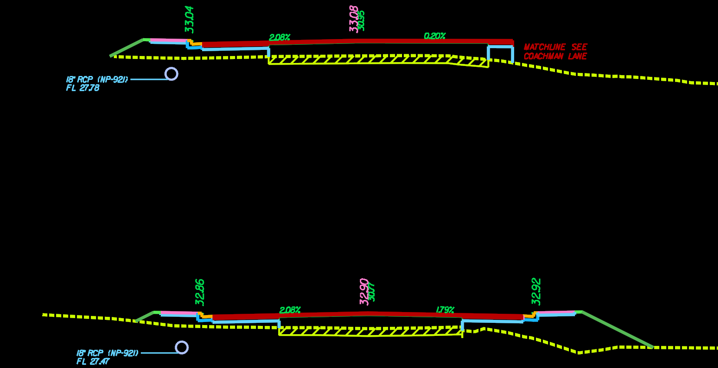
Cross Section of Glenn's Bay Rd

Slide 6
Project Schedule
Construction bids received on July 8, 2014. Low bidder was Southern Asphalt in the amount of $46,389,431.35
Contractor notice to proceed to be issued in November 2014
Clearing activities and utility relocations along Glenn's Bay Rd. will begin in late 2014.
Construction is anticipated to be complete Fall 2017.

Slide 7
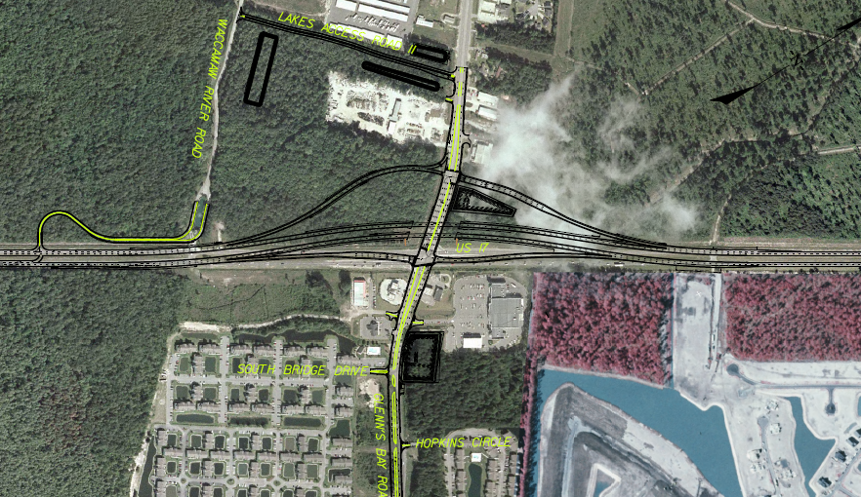
Traffic Control on US 17 Bypass

Slide 8
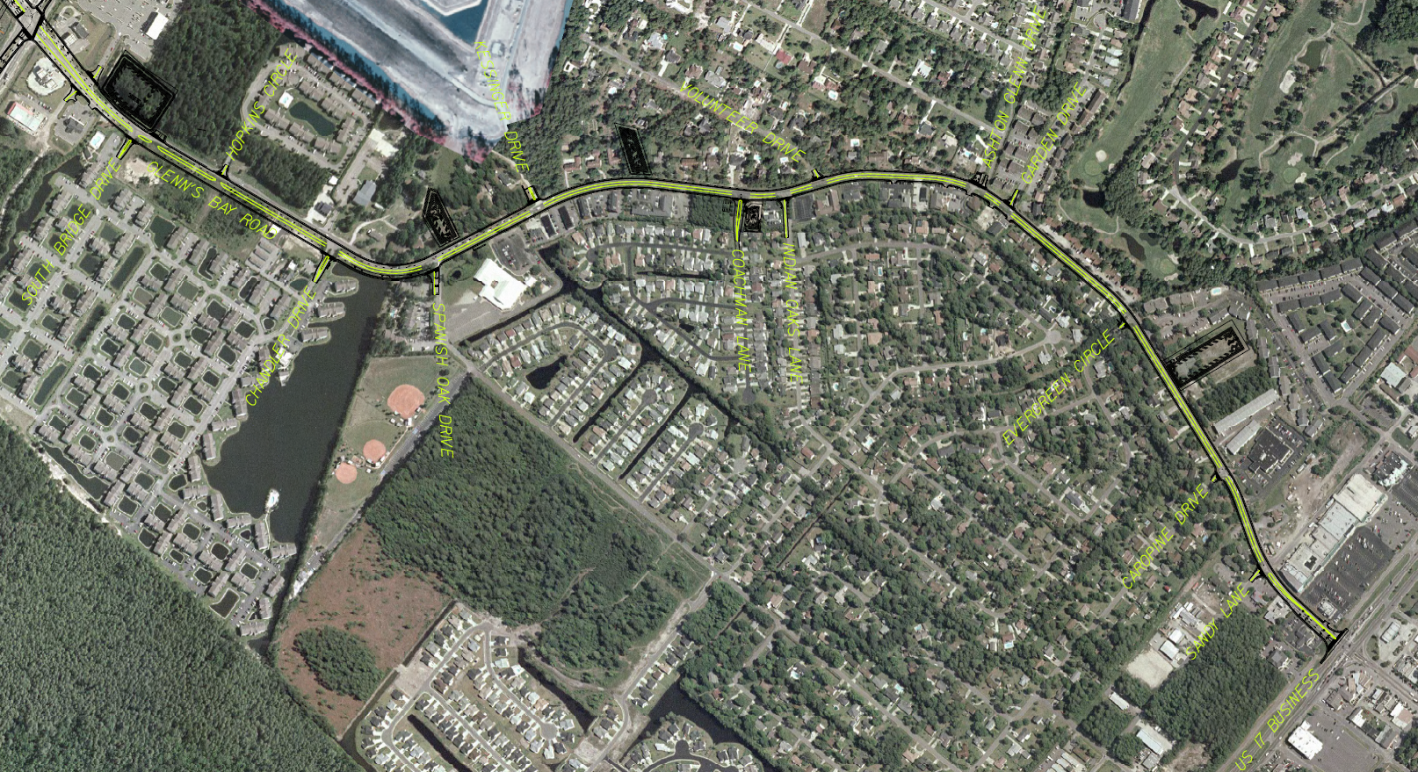
Traffic Control on Glenn's Bay Rd.

